Slide 1
Chapter 7
String and pointer

Slide 2
String Operation
string
用双引号括起来的字符序列。
“China”
长度不限，末尾加’\0’
How to store string?
Character Array
char c[6];
C
H
I
N
A
\0
length = 5
c[0]
c[1]
c[2]
c[3]
c[4]
c[5]
The length of the string: character number of the string.
The end of the string: the character ‘\0’

Slide 3
字符数组的定义
格式： 类型说明符 数组名[维数说明];
例： char a[4],b[10];
char c[3][4];
表示a数组可以存放4个字符，c数组可以存放12个字符。
字符数组的用途
一维字符型数组作为一个字符串变量使用。
二维字符型数组相当于一个字符串数组，每行
存放一个字符串。
例：c[3][4]可存放三个字符串，每个字符串最多存放4个字符。

Slide 4
String Operation
String Initializing
用字符串对字符数组初始化:
char c[20]={ “china”};
char ch[6]={ "CHINA“ };
char ch[6]= " CHINA”;
char ch[ ] = "CHINA";
  用单个字符对字符数组初始化:
char ch[6]={ 'C','H','I','N','A','\0'};
char str[20];
scanf(“%s”, str);
char str[20];
gets( str);

Slide 5
字符数组的输入与输出
字符数据的输入/输出
从键盘上
读一个字符
格式化输入输出函数：
scanf( ),printf( ),”%c”
库函数：
getchar( ),putchar(ch)
使用getchar( )时，可以输入任何字符，允许用户根据自己的要求进行控制与处理，串尾\0要自己编程加入。 [ENTER]键系统接受为\n。

Slide 6
字符数组的输入与输出
单字符输入输出 (用格式符％c控制〕
static char a[3];
for (i=0;i<3;i++)
scanf("%c",&a[i]);
for (i=0;i<3;i++)
printf("%c",a[i]);
printf("\n");
输入数据顺序：
d
o
s
输出数据顺序：
dos

Slide 7
字符串输入输出 (用格式符％s控制〕
static char a[7];
scanf("%s",a);
只能输入不包括空格、\t和\n的字符串
自动在串尾加’\0’。
printf("%s\n",a);
‘\0’不输出

Slide 8
字符串在数组中的存储格式
  ’\0’是在字符串存入字符数组时由系统自动添加的，并不是字符串本身的一部分，在计算串长的时候并不包括 ’\0’。
  使用字符’\0’作为字符串的结束标记，就使得C语言对字符串的长度没有具体的限制，但字符串的最大长度不能超过存储它的字符数组的长度，否则会造成数组越界错误。

Slide 9
String Operation
String Operation
String input/output
Get string length
String copying
String comparing
String concatenation
String reversing
Extracting parts of a string

Slide 10
String input/output
gets (str_name);
//功能：由终端输入字符串到字符数组，以换行结束， 返回字符数组的首地址
scanf(“%s”, str_name);
Example:
void main()
{
char str[20];
gets(str);
puts(str);
}
puts (str_name);
功能：将以\0结束的字符串输出到终端，返回的函数值是字符数组的首地址。
printf(%s”, str_name);

Slide 11
字符串长度(strlen)
void main()
{
int a;
char x[20];
scanf("%s",x);
a=strlen(x);
printf("%d\n",a);
}

Slide 12
Get String length
#include <stdio.h>
  void main ( )
  { int length;
  char str[100];
  gets(str);
  length=0;
  while ( str[length] != ’\0’ )
  length ++;
  printf (”String length = %d”, length);
  }
length=0
length=1
length=2
length=7
a
b
c
d
e
f
g
\0
String length

Slide 13
字符串连接函数(String concatenation)
格式：strcat（字符数组1，字符数组2 ）
功能：连接两个字符数组中的字符串，将串2接在串1后，结果存放在字符数组1中，返回的函数值是字符数组1的首地址。
字符数组1的长度要指定，而且要足够大。

Slide 14
例：字符串连接。将串str2连接到串str1之后。
根据字符串中 \0 的位置进行字符串连接。
关键：要用str2的第1个字符覆盖str1的串结束标记\0。
算法：
1、查找str1的串结束标记\0
2、从str1的\0开始，将str2复制到str1。
str2
a
b
c
d
e
f
g
\0
...
...
...
str1
x
y
...
z
\0
a
b
c
d
e
f
g
\0

Slide 15
String concatenation
  #include <stdio.h>
  void main( )
  { char str1[100],str2[100];
  int i, j;
  printf (”Enter string 1:”);
  gets (str1);
  printf (”Enter string 2:”);
  gets (str2);
  for ( i=0; str1[i]!=’\0’; i++ ) ； /* find \0 in str1 */
  for ( j=0; (str1[i]=str2[j]) != ’\0’; i++, j++ ) ；
  printf(”Output string 1:%s\n”, str1);
  }

Slide 16
字符串复制函数strcpy
格式：strcpy（字符数组1，字符数组2 ）
功能：将串2复制到串1数组中。

Slide 17
例：字符串复制。
将字符串 str1 拷贝到串 str2 中。
根据字符串中 \0 的位置，只对 \0 前面的字符进行复制。
str1
a
b
...
...
...
f
g
\0
...
...
...
#include <stdio.h>
  void main ( )
  { char str1[100], str2[100];
  int i;
  printf ("Enter string 1:");
  gets (str1); /* 输入字符串str1 */
  for (i=0;(str2[i]=str1[i])!=’\0’; i++) ；
  /* 复制*/
  printf("Output string 2:%s\n", str2);
  }
str2
a
b
...
...
...
f
g
\0

Slide 18
字符串比较函数strcmp
格式：strcmp（字符数组1，字符数组2 ）
功能：比较串1和串2，结果为：
0--相等，正数--串1大，负数--串2大
比较原则：
按照串中对应位置字符的ASCII码值的大小确定大小。
”abc” 与 ”abc” ，相等
”abc” 与 ”b”
”abc” 与 ”abadef”
”abc” 与 ”ab”
”abc” < ”b” 因为字符 ‘a’ < ‘b’
”abc” > ”abadef” 因为字符 ‘c’ > ‘a’
”abc” > ”ab” 因为字符 ‘c’ > ‘\0’

Slide 19
String comparing
example:
str1=“abc”; str2=“b”;
str1=“abc”; str2=“abadef”;
str1 < str2
str1 > str2
void main( )
{ char str1[100], str2[100]; int i;
printf (“Enter string 1:”); gets(str1);
printf (“Enter string 2:”); gets(str2);
for ( i=0; (str1[i]==str2[i]) && str1[i]!=‘\0’; i++);
if ( str1[i] == str2[i] ) printf (“str1==str2\n”);
else if (str1[i] > str2[i]) printf (“str1>str2\n”)
else printf (“str1<str2\n”);
}

Slide 20
大小写字母转换
strlwr(x)
所有大写字母转换成小写字母
strupr(x)
所有小写字母转换成大写字母

Slide 21
String reversing
str
a
k
b
j
i
c
d
\0
e
f
g
h
c
i
j
b
k
a
\0
j=0
1
2
8
9
i=10
j=0,1,2,3,
i=10,9,8,7,
void main ( )
{
char str[100], c;
int i, j;
printf (”Enter string:”); gets (str);
for ( i=0; str[i]!=’\0’; i++ ) ;
i--;
for ( j=0; j<i; i--, j++ )
{ c=str[i]; str[i]=str[j]; str[j]=c; }
printf(”Output string:%s\n”, str);
}

Slide 22
求子串(Extracting parts of a string)
从字符串 str 的第 m 个位置上开始，截取 n 个字符生成子串 sub。
要考虑三种情况：
1. m<串长，m+n<=串长
正常截取 n 个字符
2. m<串长，m+n>串长
取从m开始的字符串 (<n个)
3. m>=串长
不截取，sub为空串
m
n
str
d
g
...
h
\0
a
...
...
f
...
f
c
\0
...
...
sub
h
a
...
...
f
\0

Slide 23
#include <stdio.h>
void main( )
{ char str[100], sub[100];
int m, n, k, l;
printf (”Enter string:”); gets(str);
printf (”Enter m n:”); scanf(”%d%d”, &m, &n);
for ( k=0; k<m-1 && str[k]!=’\0’; k++ ) ；
/* 找开始位置 */
for ( l=0; l<n && (sub[l]=str[k])!=’\0’; k++,l++) ；
sub[l]=’\0’; /* 在串sub的后面加上串结束标记 */
printf (”sub=%s\n”, sub);
}

Slide 24
二维字符数组的定义与初始化
char a[2][3] ,b[3][5];
char a[3][8]={”str1”,”str2”,”string3”};
char b[ ][6]={”s1”,”st2”,”str3”};
a[0][0]
a[0]
s
t
r
1
\0
\0
\0
\0
a[1]
s
t
r
2
\0
\0
\0
\0
a[2]
s
t
r
i
n
g
3
\0
a数组初始化后的存储情况
可将二维数组当作一维数组使用，这个一维数组中的每个元素是个一维数组。

Slide 25
二维字符数组的引用
对已定义的a,b引用：
for (i=0;i<3;i++)
printf(”%s\n”,a[i]);
for (i=0;i<3;i++)
printf(”%c\n”,a[i][i]);
for (i=0;i<3;i++)
printf(”%s\n”,&a[i][i+1]);
/* 输出i行字符串 */
/* 输出i行i列字符 */
/* 输出i行i+1列字符
开始的字符串 */

Slide 26
String
a number of characters packed together as a single unit, e.g. “Hello world!\n”
Consider a naive thinking on string, let say we want to declare a string
string str_a, str_b, str_c;
to initialize the string,
str_a = “a message we like ”;
to add some words to the end of the string i.e. concatenate
str_b = str_a + “that we want to use as an example”;
to compare it against another string
if (str_b == str_c)
printf(“two strings are equal!\n”);
However the above are all wrong in C!

Slide 27
Why?
No string data type in C!
C use character array to represent and store a string
Direct assignment of a string is invalid
name of the string is an equivalent array name, thus an address constant
str_a = “a message we like ”; // error in assigning some values to a constant
‘+’ cannot be used to perform concatenation of strings
str_b = str_a + “that we want to use as an example”;
has the following errors:
  address constant on LHS of assignment
  addition operation on RHS involves meaningless address addition
Comparing of two strings cannot be done by using ‘==’
if (str_b == str_c)
printf(“two strings are equal!\n”);
just involves the comparison between two addresses

Slide 28
char aa, bb[4], cc[100], dd[100];
FILE *outfile;
outfile = fopen ("L7_1.out","w");
printf ("********** Section 1 - Initializing ************\n");
aa = 'g';
bb[0] = 'C';
bb[1] = 'a';
bb[2] = 't';
bb[3] = '\0';
strcpy (cc,"This is a string constant, also called a string literal.");
strcpy (dd,cc);
printf ("\n********** Section 2 - Printing **********\n");
putchar (aa);
putc (aa, outfile);
fputc (aa, outfile);
puts (bb);
fputs (bb,outfile);
printf ("%s\n",bb);
fprintf (outfile,"%s\n",bb);
puts (cc);
puts (dd);
printf ("addresses aa=%p, bb=%p, cc=%p, dd=%p\n",&aa,bb,cc,dd);

Slide 29
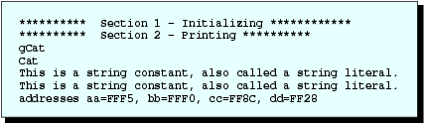
Ouput
Output to screen
Output to file
ggCatCat

Slide 30
String
array of characters including the terminating null (\0) character
e.g. “Cat” in array bb[] is stored as
bb[0]='C';
bb[1]='a';
bb[2]='t';
bb[3]='\0‘;
C automatically adds the terminating null character when it is stored in memory
Therefore character array declaration must be large enough to include the \0
C treats a string of characters enclosed in double quotes as an address
Actually C works with the address of the first memory cell at which the string is stored
when a string constant is written in a program body, C sees an address e.g.
"This is a string constant, also called a string literal.“
is treated as an address in C program

Slide 31
String functions
strcpy ( destination_string, source_string);
Example
strcpy(cc,"This is a string constant, also called a string literal.");
strcpy(dd,cc);
causes string in memory cells beginning at the address cc to be copied into memory cells beginning at address dd
Can be thought of as assignment operation of string variable
cc="This is a string constant, also called a string literal.";
is wrong as cc is an address constant, and RHS is simply an address in C

Slide 32
String functions
to print a string to the screen
puts (address);
address is the starting address of the string
puts(bb);
printf("%s\n",bb);
To print a string to a file
fputs (address, file_pointer);
fputs(bb,outfile);
fprintf(outfile, "%s\n", bb);

Slide 33

String functions
To print a character to a file
putc (character);
fputc (character, file_pointer);
E.g.
putc(a);
fputc(a,outfile);
Result of the following?
char aa, ee[2];
aa='g';
strcpy(ee, "g");
Content of aa & ee won’t be the same

Slide 34
char cc, long_string[50], many_lines[70];
int occupied, reserved, buffer_size;
printf ("****** Section 1 - conversion specifications ********\n");
strcpy (long_string,"This is a complete sentence." );
strcpy (many_lines,"This sentence \ncovers two lines.");
printf ("[[%s]]\n",long_string);
printf ("[[%40s]]\n",long_string);
printf ("[[%-40s]]\n",long_string);
printf ("[[%40.10s]]\n\n",long_string);
printf ("%s%s\n%s","This is"," one method for printing","string constants.\n");
printf ("\n****** Section 2 - finding information about strings **\n");
occupied = (int) strlen (many_lines);
reserved = sizeof(many_lines) / sizeof(char);
buffer_size = BUFSIZ;
printf ("occupied = %d \nreserved = %d\n\nOur buffer size is %d\n",
occupied, reserved, buffer_size);
if (isdigit(many_lines[0])) putchar(many_lines[0]);
cc = tolower (many_lines[0]);
putchar (cc);
putchar ('\n');
puts (many_lines);

Slide 35
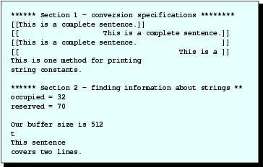
Output

Slide 36
%s in printf
General form
% flag field_width . precision s
Command and Explanation | Result
printf (“%s\n”,long_string); | [[This is a complete sentence.]]
Since no field width is given, the field width is expanded
to exactly the size of the string.
printf (“%40s\n”,long_string); | [[ This is a complete sentence.]]
Field width is 40. With no flag, result is right justified
printf (“%-40s\n”,long_string); | [[This is a complete sentence. ]]
Field width is 40. Flag causes left justification
printf(“%40.10s\n\n”,long_string); | [[ This is a ]]
Field width is 40. Precision is 10 meaning that only
the first ten characters are printed. No flag means right justification

Slide 37
strlen & sizeof
strlen - determine the number of characters actually stored in a particular string
Syntax
int strlen(address);
Example
occupied = (int)strlen(many_lines);
sizeof operator - computes the number of bytes reserved for storage of a specified variable or variable type
Syntax
unsigned int sizeof(name);
Example
sizeof(int);
sizeof(many_lines);
In sizeof(many_lines), an array name without brackets is simply an identifier.
The operator sizeof finds the allocated storage associated.

Slide 38

2D character Array
Declare with
char array_name [number_of_rows][number_of_columns];
Example
char aa[2][90];
To initialize an array
char bb[NUM_ROWS][NUM_COLS];
strcpy(bb[0],"The bb array ");
strcpy(bb[1],"has ");
strcpy(bb[2],"3 strings.");
The memory after above instructions is as follow

Slide 39
char aa[2][90], bb[NUM_ROWS][NUM_COLS];
int i, occupied, reserved;
FILE *outfile;
outfile = fopen "L7_3.OUT","w");
printf ("********* Section 1 - Initializing ***********\n");
strcpy (aa[0],"The aa[ ][ ] array ");
strcpy (aa[1],"has 2 strings.\n");
strcpy (bb[0],"The bb array ");
strcpy (bb[1],"has ");
strcpy (bb[2],"3 strings.");
printf ("********** Section 2 - Printing ************\n");
for (i=0; i<2; i++)
printf("%s",aa[i]);
for (i=0; i<NUM_ROWS; i++)
puts(bb[i]);
for (i=0; i<NUM_ROWS; i++)
fputs(bb[i],outfile);
reserved = sizeof (bb[0]);
occupied = strlen (bb[0]);
printf ("Reserved bytes for bb[0]=%d \nOccupied bytes for bb[0]=%d\n",
reserved, occupied);

Slide 40
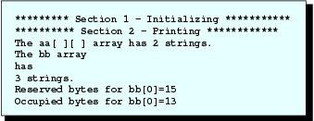
Output
Screen
Output file
The bb array has 3 strings.

Slide 41
2D Array
To determine the size of 2D array
  To determine size of a row in bb[][]
  sizeof(bb[0]);
  To determine the size of the whole array
  sizeof(bb);
  We can also use strlen
  strlen(bb[0])

Slide 42
2D Array
To print a 2D character array
puts(bb[i]);
fputs(bb[i],outfile);
print the i-th row of bb[][]
puts and fputs expects starting address of the string
Thus the following will print all the content of bb[][]
for (i=0; i<NUM_ROWS; i++) puts(bb[i]);
puts will print a newline at the end of string while fputs won’t

Slide 43
char a[40],b[3][60],c[4][100],d[50],e[30];
int i;
FILE *infile;
FILE *outfile;
infile = fopen ("L7_4.TXT","r");
outfile = fopen ("L7_4.OUT","w");
printf ("************ Section 1 for Array a[ ] *************\n");
printf ("Enter a line of text for a[ ]\n");
gets (a);
puts (a);
printf ("\n\n************ Section 2 for Array b[ ][ ] *************\n");
printf ("Type 3 lines for b[ ] and press return at the end of each one\n");
for (i=0; i<3; i++)
{
gets (b[i]);
puts (b[i]);
}

Slide 44
printf ("\n\n************ Section 3 for Array c[ ][ ] *************\n");
printf ("We will read c[ ] from a file\n");
for (i=0; i<4; i++)
{
fgets (c[i],100 ,infile);
puts (c[i]);
fputs (c[i] ,outfile);
}
printf ("************ Section 4 for Arrays d[ ] and e[ ] *************\n");
printf ("Enter a line of text for d[ ] and press return\n");
scanf ("%s",d);
puts (d);
gets (e);
printf ("This is the rest of the text entered\n");
puts (e);
Input file L7_4.TXT
We read
four lines of
text from our
input file.
Output file L7_4.OUT
We read
four lines of
text from our
input file.

Slide 45
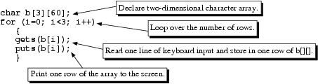
READING STRINGS FROM THE KEYBOARD AND FILES
Gets function will read a string from keyboard
gets(address);
Example
char a[40];
gets(a);
reads the string typed into the keyboard until the newline character (created by typing “Enter”)
Newline is discarded and null character append at the end of input characters

Slide 46
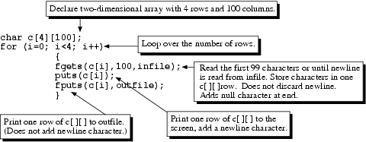
Input string from a file
Use fgets to read a string from file
fgets (address, number_of_char, file_pointer);
Example

Slide 47
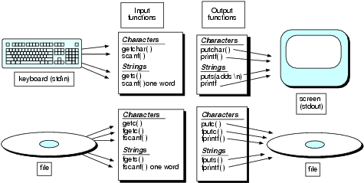
Character & String handling in C

Slide 48
Pointers and Addresses
pointer：The elite of C, import concept, import feature.
Using pointer：
1. can make program more compact,
2. be care of using pointer

Slide 49
memory user data region
Pointer is address
address
1. the address of the memory storage unit ──the serial number of the storage unit
cf. data storing in the memory storage unit
.
.
.
0000 0000
0000 0100
0000 0000
0000 0111
.
.
.
00000000
11001100
.
.
.
2000
2001
2002
2003
3010
3011

Slide 50
2. Variable address and value
(1) variable address──
The address of a variable is itself data that can be manipulated and stored in memory
(2) value——can be stored in memory
memory user data region
.
.
.
4
2
7
9
.
.
.
2004
.
.
.
2000
2002
2004
2006
3010
variable k
variable m
variable i
variable j
variable i_pointer

Slide 51
How does the compiler process variable definition ?
main()
{ int num;
scanf("%d",&num);
printf("num=%d\n", num);
}
C compiler does operate as follows when it compile variable definition statement ” int num”:
(1) distribute variable memory space
(2) login variable num to "symbol table"
each variable in symbol table contains two attribute：
1) variable name（id）
2) its address （addr）
variable address

Slide 52
3. The access of variable value
(1)Direct access
scanf(”%d”,&m);
printf(”%d”, m);
m=m+i;
(2) indirect access
visit variable value through another variable (a pointer variable)
Example:
define a pointer ” i_pointer”
i_pointer= &i ；
scanf(“%d”,i_pointer);
Memory user data region
2000
2002
2004
2006
3010
.
.
.
4
2
7
9
.
.
.
2004
.
.
.
Variable k
Variable m
Variable i
Variable j
Variable i_pointer

Slide 53
4. Pointer variable points to a variable
The definition of pointer variable
general format：
base-type * pointer-variable ;
where：base-type is the type of the value to which the pointer points
pointer-variable is the variable being declared
for examples,
int *p1;
char *p2;
1).using a pointer variable
assignment of a pointer variable
value ( to assign an address to a pointer)
for example, int *p1,*p2, i; p1=&i; p2=p1;
p1
i
p2

Slide 54
2). to assign a value to a variable with pointer variable
“*”：pointer operator、indirection operator is an unary operator (value-pointed-to)
for example , int i , j , *p;
p=&i;
*p=3; // namely i=3;
j=*p+2;
After definition
After p=&i
after *p=3
after j=*p+2
:
:
:
:
1000
1002
1004
1000
1002
1004
i
j
p
1000
1002
1004
i
j
p
i
j
p
3
1000
1000
1002
1004
3
5
1000
i
j
p
1000
Pointer variable must be assigned a value before it is
used ,or it becomes a hanging pointer!

Slide 55
operator & and * ：
（1）associativity(结合性） : from right to left
if： int a, *p1;
p1=&a;
then： &*p1 =&(*p1)=&(a)=&a=p1
*&a =*(&a)=a
（2）priority
* prior to &

Slide 56
3）.”--”and “++”operator mostly apply to arrays’ pointer
if ： float x,*p1;
p1=&x;
if p1=1000, then p1++ is 1004 example：
int a,b,*p;
p=&a; a=3; b=5;
(*p)++; the equivalence is a++ a==4
*p++; the equivalence is *(p++)
if p=1000, then p++ is 1002

Slide 57
[ex.1]The indirect access of variables
main()
｛ int a，b;
int *pointer_1, *pointer_2；
a=100；
b=10；
pointer_1=&a； /*to assign a’s address to pointer_1*/
pointer_2=&b；/* to assign b’s address to pointer_2*/
printf （”％d，％d\n”, a，b)；
printf（”％d，％d\n”, *pointer_1，*pointer_2）；
}
The results：
100, 10
100, 10
pointer1
a(*pointer1)
&a
100
pointer2
b (*pointer2)
&b
10

Slide 58
[ex.2]Input two integers a and b ,output them ordered by value .
main()
{ int *p1，*p2，*p, a, b；
scanf （"％d％d"，&a，&b）；
p1=＆a；
p2=＆b；
if (a＜b)
{p=p1；pl=p2；p2=p;}
printf （"\na=％d,b=％d\n”，a，b）；
printf（"max=％d,min=％d\n"，*pl，*p2）；
}
results： 5 9 ↓ a＝5，b＝9 max＝9，min＝5
if(*p1<*p2)

Slide 59
p1
a
p
&a
5
p2
b
&b
9
p1
a
p
&b
5
p2
b
&a
9

Slide 60
Modify program as follows:
main()
{ int *p1，*p2，p, a, b；
scanf （"％d％d"，&a，&b）；
p1=＆a； p2=＆b；
if (*p1＜*p2)
{p=*p1；*pl=*p2；*p2=p;}
printf （"\na=％d,b=％d\n”，a，b）；
printf（"max=％d,min=％d\n"，*pl，*p2）；
}
question： analyses function result
5 9 ↓
a＝?，b＝?
max＝?，min＝?

Slide 61
4).pointer variable act as function parameter
question：can the swap function able to realize two variable exchange?
void swap(int p1,int p2)
{ int t;
t=p1; p1=p2; p2=t;
}
main()
{ int a,b;
printf("a,b=");
scanf("%d%d",&a,&b);
swap(a,b);
printf("a=%d,b=%d\n",a,b);}
a
b
3
6
3
6
p1
p2

Slide 62
[ex.3] pointer variable act as function parameter
void swap(int *p1,int *p2)
{ int t;
t=*p1; *p1=*p2; *p2=t;
}
main()
{ int a,b;
printf("a,b=");
scanf("%d%d",&a,&b);
swap(&a,&b);
printf("a=%d,b=%d\n",a,b);
}
a
b
3
6
Transfer value(address)
&a
&b
p1
p2

Slide 63
1. Pointer points to an array
1). summarization
conception
int a[5];
Array ‘s pointer (head address)，array name :a
element’s pointer (address):
a or &a[0]
a+1 or &a[1]
a+2 or &a[2]
a+3 or &a[3]
a+3 or &a[4]
element value (name)
a[0] or *(a+0)
a[1] or *(a+1)
a[2] or *(a+2)
a[3] or *(a+3)
a[4] or *(a+4)

Slide 64
2) Declare a pointer of one-dimensional array
For example, int a[5], *p=a (or *p=&a[0]);
element’s pointer：
p or&p[0]
p+1 or&p[1]
p+2 or&p[2]
p+3 or&p[3]
p+3 or&p[4]
Array element(name)
p[0] or *(p+0)
p[1] or *(p+1)
p[2] or *(p+2)
p[3] or *(p+3)
p[4] or *(p+4)
instruction：int a[5], *p=a (or&a[0]);
namely： int a[5], *p;
p＝a；

Slide 65
3)Quoting one-dimensional array element
element value element address
Subscript method： a[i] &a[i] visual
Pointer method ： *(a+i) a+i
*(p+i) p+i
object program occupys memory fewer and run fast.
The difference between p and a:
a: address constant
p: address variable

Slide 66
[ex.1] The quotation of array ‘s elements
First:subscript method
main()
{ int a[10], i;
printf(“Input 10 numbers: ”);
for(i=0; i<10; i++)
scanf(“%d”, &a[i]);
printf(“a[10]: ”);
for(i=0; i<10; i++)
printf(“%d ”, a[i]);
printf(“\n”);
} results：
Input 10 numbers: 0 1 2 3 4 5 6 7 8 9←┘
a[10]: 0 1 2 3 4 5 6 7 8 9
Second ：array name
main()
{ int a[10], i;
printf(“Input 10 ...: ”);
for(i=0; i<10; i++)
scanf(“%d”, a+i);
printf(“a[10]: ”);
for(i=0; i<10; i++)
printf(“%d”, *(a+i));
printf(“\n”);
}

Slide 67
third：pointer variable
main()
{ int a[10], i, *p=a;
printf(“Input 10 ... : ”);
for(i=0; i<10; i++)
scanf(“%d”, p+i);
printf(“a[10]: ”);
for(i=0; i<10; i++)
printf(“%d ”, *(p+i));
printf(“\n”);
}
four：pointer variable ++
main()
{ int a[10], *p;
printf(“Input 10 ... : ”);
for(p=a; p<a+10; p++)
scanf(“%d”, p);
printf(“a[10]: ”);
for(p=a; p<a+10; p++)
printf(“%d ”, *p);
printf(“\n”);
}
pay attention to the difference between p+1 and p++！

Slide 68
3. Two-dimensional array’s pointer
Two –dimensional array‘s pointer :
example: int a[3][4];
a[0][0] a[0][1] a[0][2] a[0][3]
a[1][0] a[1][1] a[1][2] a[1][3]
a[2][0] a[2][1] a[2][2] a[2][3]
row pointer
secondary pointer
a
a[0]
a[1]
a[2]
1.1 3.2 5.1 7.3
2.5 4.6 7.8 8.8
4.5 6.7 3.9 2.6
a+0
a+1
a+2
column pointer
firstlevel pointer

Slide 69
discription：two_dimentional array has some features :
array name “a” stands for the starting address
and a row pointer that controls a line.
a+i： row pointer ，points to line i
*(a+i) or a[i]: col pointer ，points to line i column 0
the format of how to access a[i][j] with pointer.
a[i][j]
*(a[i]+j)
*(*(a+i)＋j)
(*(a+i))[j]

Slide 70
analyses：
a[i]+j： column pointer points to array element a[i][j].
*(a[i]+j)： the value of array element a[i][j] .
If int a[3][4], *p=a[0]；
so p+1 point to ？
how to use p as pointer to access a[i][j]?

Slide 71
指针的算术运算
指针的算术运算除了用于数组外没有什么意义。
指针可以进行如下的算术运算：自增运算(++)、自减运算(－－)、加上一个整数(＋或＋＝)、减去一个整数(－或 －＝)、减去另一个指针。
常见错误：
  对不指向数组的指针进行算术运算；
  把不指向同一数组的两个指针相减或比较；
  指针算术运算的结果超出了数组的范围
指针算术运算的结果依赖于指针所指向对象的大小。当指针加上或减去一个整数时，并非将指针变量中的地址简单加上或减去该整数值，而是加上该整数与指针所指对象大小的乘积。即p＋i 表示的含义为：p＋i×d。

Slide 72
character pointer and function
1. The denotation and quotation of character string
character array : quote character one by one
character pointer variable : whole quote
1)quote character one by one
[ex.3] use character pointer variable to express and quote character string .
main()
{ char *string=“I love China”;
for(; *string!=’\0’; string++) printf(“%c”, *string);
printf(“\n”);
}
results： I love China

Slide 73
string:character pointer variable
Description ：
(1)、 char *string="I love China";
definition and initialization string：
string =the starting address of character constants
amount to ：char *string；
string=“I love China”；
string
(2)、 differ from character string
char str[ ]=“I love China”
str[0] str[7]
str
I l o v e C h i n a \0
I l o v e C h i n a \0
str=“I love China’’ 错误

Slide 74
2).Whole quotation
[ex.4] use whole quotation and modify[ex.3]。
main()
{ char *string=”I love China”;
printf(“%s\n”,string); }
whole quote theory：first of all output the first directional character
pointer automatic plus 1 point the next character reduplicate the above process until counter with character string closing flag
string
The compare of the character pointer variable and character array
(1）memory contents differ
（2）assign value mode differ
（3）character pointer value could modify, but array name not
I l o v e C h i n a \0

Slide 75
2. string pointer act as function parameter
[ex.5] use function call mode and copy character string
void string_copy(char *str_to, char *str_from)
{ int i=0;
for(; (*(str_to+i)=*(str_from+i))!=’\0’; i++) ;
/*loop body is blank statement*/
}
main()
{char array_str1[20]=”I am a teacher.”;
char array_str2[20];
string_copy(array_str2, array_str1);
/*array name is real parameter*/
printf(“array_str2=%s\n”, array_str2);
}
results：
array_str2= I am a teacher.

Slide 76
POINTER VARIABLES vs. ARRAY VARIABLES
when working with strings, address of the first element of a string frequently used
convenient to simply store the address of the first element
to declare a pointer variable
char *aa;
char *cc[5];
reserves five address of character i.e. array of pointers
Can be used to manipulate strings and characters in strings

Slide 77
char *aa;
char bb[25];
char *cc[5];
char dd[5][30];
char ee[25], ff[30];
int i, j;
strcpy (ee,"This is a sample string.");
strcpy (ff,"Another string.");
printf ("*********** Section 1 - Initializing **************\n");
aa = ee;
cc[0] = ff;
cc[1] = ee;
strcpy (bb,ee);
strcpy (dd[0],ff);
strcpy (dd[1],ee);
printf ("*********** Section 2 - Printing using puts **************\n");
puts (aa);
puts (bb);
puts (cc[0]);
puts (dd[0]);

Slide 78
printf ("*********** Section 3 - Printing using putchar **************\n");
for (i=0; i<10; i++)
putchar(aa[i]) ;
putchar ('\n');
for (i=0; i<10; i++)
putchar(bb[i]);
putchar ('\n');
for (i=0; i<2; i++)
{
for (j=0; j<10; j++)
putchar(cc[i][j]);
putchar('\n');
}
for (i=0; i<2; i++)
{
for (j=0; j<10; j++)
putchar(dd[i][j]) ;
putchar('\n');
}

Slide 79
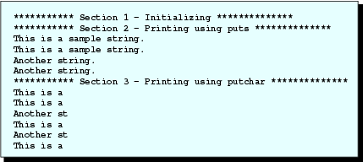
Output

Slide 80
Pointers & array
difference in the declarations
char *aa;
char bb[25];
  first declaration reserves a single memory location for pointer aa
  second declaration reserves 25 locations for character values
difference in the declarations
char *cc[5];
char dd[5][30], ee[25], ff[30];
  first declaration reserves five pointer variables
  second declaration reserves five memory regions with each containing cells for 30 characters

Slide 81
Pointers & Array
statements
char *aa;
char *cc[5] dd[5][30], ee[25];
aa = ee;
cc[0] = ff;
cc[1] = ee;
are valid as aa is a pointer variable and
cc[0] and cc[1] are elements of an array of pointer variables =>can store addresses and ee and ff indicate addresses

Slide 82
Pointer & Array
char *aa, ee[25], ff[30], dd[5][30], bb[25]; strcpy(bb,ee);
strcpy(dd[0],ff);
strcpy(dd[1],ee);
are valid as actual characters of the strings ee and ff are copied into memory cells beginning with the addresses bb, dd[0], and dd[1] (character pointers)
Using array of pointers to print strings
cc[0]=ff;
cc[1]=ee;
puts (cc[0]);
puts (cc[1]);

Slide 83
Pointer & Array
char *aa, ee[25], ff[30], dd[5][30], bb[25];
C allows use of array notation with pointer to access elements of an array
aa=ee;
for(i=0; i<10; i++) putchar(aa[i]) ;
And also
cc[0]=ff;
for(j=0; j<10; j++) putchar(cc[0][j]);
cc[0][0] refers to the first character of the ff[ ] array

Slide 84

Pointer & Array
C allows use of array notation with pointer
when a program is compiled, it converts array notation to pointer notation
In principle, both pointer and array can access an element at a particular address or a number of elements past a given address
Further processing is same as in normal character operation
char *aa, ee[25], ff[30], dd[5][30], bb[25];

Slide 85
String initialization
To initialize character arrays, use strcpy
To initialize pointer variables and pointer arrays, use assignment statements.
use similar methods to access strings and individual characters. i.e. can use array notation [ ] with both pointers and arrays to access strings and individual characters.

Slide 86
Initilializing within a Declaration
within a declaration, characters enclosed in quotes sometimes do not represent addresses
When initialize pointers and pointer arrays, quote-enclosed characters do represent addresses
to access a string constant, must use its address because no name is associated with it

Slide 87
char *aa = "We can use a pointer to a string constant.";
char bb[ ] = "We can also use an array.";
char *cc[ ] = {"We can","use an array","of pointers to a constant."};
char dd[ ][11] = {"Or we can","use a 2-D","array."};
int i ;
printf ("Addresses: \n\taa=%p \n\tcc[0]=%p \n\tcc[1]=%p \n\tcc[2]=%p"
“\n\tbb=%p \n\tdd[0]=%p \n\tdd[1]=%p \n\tdd[2]=%p \n",
aa, cc[0], cc[1], cc[2], bb, dd[0], dd[1], dd[2]);
puts (aa);
puts (bb);
for (i=0; i<3; i++)
puts(cc[i]);
for (i=0; i<3; i++)
puts(dd[i]);

Slide 88
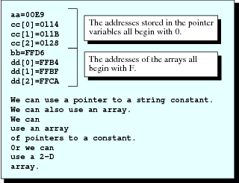
Output

Slide 89
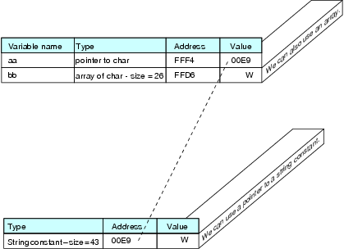
Pointer
Declare a pointer and specify the string it points
char *aa="We can use a pointer to a string constant.";
Address (pointer) print using %p
address of string constant is much smaller in value than that of other variables c.f. 00 vs FF
Difference between
char *aa={"We can use a pointer to a string constant."};
char bb[ ]={"We can also use an array."};
  First statement causes address of string constant to be stored in aa’
  Second causes the string actually to be stored in memory for bb[ ] array

Slide 90
Pointer
Similarly
char *cc[ ]={"We can","use an array","of pointers to a constant."};
char dd[ ][11]={"Or we can","use a 2-D","array."};
  First statement causes 3 addresses of first characters of string constants, rather than characters themselves, to be stored in pointer array
  Second declaration causes actual characters of strings to be stored in memory for 2D array dd[]
declaring dd[ ][ ] as 2-D array causes “rectangular” shaped memory region to be reserved, in this case 3 x 11
declaring cc[ ] produces three separate 1-D arrays, allowing C to size each one correctly without wasting memory.

Slide 91
Pointer
To access individual characters of strings pointed to by cc, use array notation just as 2D array
Example
cc[1][4] represents fifth character ‘a’ of second string
assignment statements
aa = "We can use a pointer to a string constant.";
is valid,
bb = "We can also use an array";
is invalid because bb was given an address during compilation (since it is an array) and is fixed (constant)

Slide 92
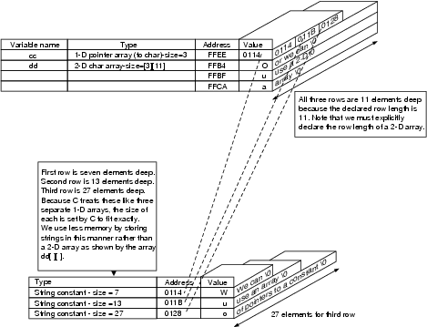
Pointer

Slide 93
Passing string to function
four different types of declarations for strings
  One-dimensional character arrays
  Two-dimensional character arrays
  Pointers to strings
  Arrays of pointers to strings
We try passing in 4 ways to a function

Slide 94
void main (void)
{
char aa[ ] = "One-dimensional array.";
char bb[ ][LENGTH] = {"Two-","dimensional ","array."};
char *cc = "Pointer to string constant.";
char *dd[ ] = {"Array ","of pointers ","to string ","constants."};
int num_rows_bb, num_elems_dd;
num_rows_bb = sizeof(bb)/LENGTH;
num_elems_dd = sizeof(dd)/sizeof(char *);
function1(aa, bb, cc, dd, num_rows_bb, num_elems_dd);
}

Slide 95
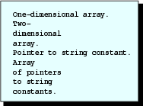
void function1 (char ee[ ], char ff[ ][LENGTH], char *gg, char *hh[ ], int num_rows_ff, int num_elems_hh)
{
int i;
puts(ee);
for (i=0; i<num_rows_ff ; i++)
puts(ff[i]);
puts(gg);
for (i=0; i<num_elems_hh; i++)
puts(hh[i]);
}
Output

Slide 96
Function parameter declaration
With the function call
function1(aa, bb, cc, dd, num_rows_bb, num_elems_dd);
we have passed
address of first element of aa[ ]
address of the first element of bb[ ][ ]
cc, which is an address as it is a pointer
address of first element of dd[ ]
Header for function1 is
Header in main Header in function1
char aa[ ] char ee[ ]
char bb[ ][LENGTH] char ff[ ][LENGTH]
char *cc char *gg
char *dd[ ] char *hh[ ]

Slide 97
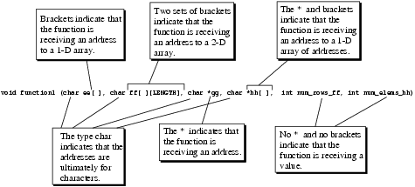
Function parameter declaration
With the function call
function1(aa, bb, cc, dd, num_rows_bb, num_elems_dd);
function must have enough information to properly perform the pointer arithmetic i.e. with the passed address, to work with the correct memory locations

Slide 98
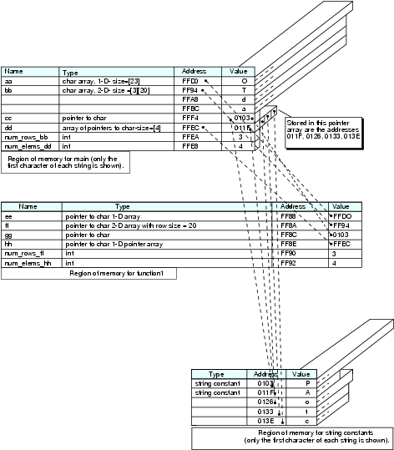

Slide 99
Pointer Arithmetic
To determine the number of rows of bb[ ][ ] and the number of elements of dd[ ]
num_rows_bb = sizeof(bb)/LENGTH;
num_elems_dd = sizeof(dd)/sizeof(char *);
important to pass the size of an array through the parameter list
Pointer arithmetic - arithmetic (+, -) performed with addresses
hh[1]
*(hh+1)
They are equivalent and that
hh+1 is equivalent to address form as hh+4 (for an address occupying 4 bytes
puts (*(hh+1));
puts(hh[1]);
is equivalent : both prints the string “of pointers”

Slide 100
Function | Description
atoi ia=atoi(“-123.45xyz”); #include<stdlib.h> | Converts a character string in the form of "whitespace sign digits" to an int value. The function returns 0 if the input cannot be converted. In case of overflow, the return value is undefined. The example converts only the characters 2123 to int. Therefore, ia = -123. Note: If any character other than whitespace is before sign digits, no conversion occurs
atof da=atof(“-987.65E+01pqr”); #include<stdlib.h> | Converts a character string in the form of "whitespace sign digits .digits d|D|e|E sign digits" to a double. The function returns 0.0 if the input cannot be converted. In case of overflow, the return value is undefined. The example converts all characters except pqr to double. Therefore, da = -987.65E + 01. Note: If any character other than whitespace is before sign digits, no conversion occurs.
atol la=atol(“-456.89abc”); #include<stdlib.h> | Converts a character string in the form of "whitespace sign digits" to a long int value. The function returns 0 if the input cannot be converted. In case of overflow, the return value is undefined. The example converts only the characters 2456 to long. Therefore, la = -456. Note: If any character other than whitespace is before sign digits, no conversion occurs.
strcat pa=strcat(hello, " morning!"); #include<string.h> | Appends a copy of the second string, “morning!”, to the first string indicated by the address, hello, and returns a pointer to the first string to which the second string has been concatenated (that is, connected or appended). The first character of “morning!” overwrites the null character of hello. The array, hello[ ], must have declared enough space to accommodate “morning”. Note: Prior to executing this code, the string hello[ ] is, “Good”. After executing the code, the string, hello[ ], is, “Good morning!

Slide 101
strchr pb=strchr(hello,’m’); The string hello[ ] is, “Good morning! | Finds the specified character, m, in the string pointed to by hello. Returns a pointer, assigned to pb, to the first occurrence of ‘m’ in the string hello. A null pointer is returned if ‘m’ is not found in hello. The position of ‘m’ within the string hello can be calculated using the statement pos=pb-hello+1; where pos, converted to int, indicates the position of ‘m’ in the hello string.
strcmp ia=strcmp(hello,"Good xyz"); The string hello[] is, “Good morning! | Compares the first string, hello, and the second string, “Good xyz”, lexicographically. Returns an int value, assigned to ia, as follows: ia < 0, first string is less than the second string ia = 0, first string is identical to the second string ia > 0, first string is greater than the second string In this example, the first five characters in both strings are identical, but the sixth characters are different. The characters are ‘m’ and ‘x’, which have ASCII values of 109 and 120, respectively. The return value ia is calculated as follows: ia='m' - 'x' = 109-120 = -11. which indicates that the string hello [ ] (which is “Good morning!”) is less than the string “Good xyz!” meaning that “Good morning” comes before “Good xyz” in alphabetical order.
strcpy pa=strcpy(hello, ”Good Morning!”); After execution, the string hello[ ] is, “Good morning!” #include<string.h> | Copies the second string into the memory cells reserved for the first string, hello. Returns a pointer, assigned to pa, that points to the first string. Note: This function was not used in the lesson’s program. Please see Lesson 7.3 for its use.

Slide 102
Strlen len=strlen(hello); The string hello[ ] is, “Good morning!” #include<string.h> | Returns the length in bytes of string, hello [ ] (which is “Good morning!”). The length does not include the string terminating null character. In the example, len = 13.
Strncat pb=strncat(hello," John. How are you!",5); #include<string.h> | Appends the first five characters of the second string to the first string, hello [ ]. The first character in the second string overwrites the terminating null character in the first string. A null character from the second string is not copied; however, a null character is added to the end of the concatenated string. This means that the concatenated string will not have two null characters at the end. The first string must have enough declared size to accommodate the second string being added to the end. Returns a pointer, pb, to the new concatenated string hello[ ]. Note: Before executing this code the string hello[ ] is, “Good morning!” After executing the code, the string, hello[ ], is, “Good morning! John.”
strcspn pos = strcspn(hello, “dog”); The string hello[ ] is, “Good morning!” #include<string.h> | Finds the first occurrence of any character in the second string in the first string, hello [ ] (which is “Good morning”). Returns the position (meaning the location relative to the first character) of the first character in the first string that also appears in the second string. For example, two characters, d and o, in the second string can be found in the first string. Since the position of character ‘o’ is in front of the position of character ‘d’, the return value, pos, is the position of character ‘o’ in the first string, which is 2. Note that because white space is a character, two strings with white space may match white space and no other character.

Slide 103
char aa[35]={"This is a one-dimensional array"};
char bb[5][40]={"We can","use both","array and pointer",
"notation to access","one and two-dimensional arrays"};
char cc[2][3][20]={"A three ","dimensional ","array ","is ","shown ","also"};
char *dd;
printf ("**************** Section 1 1-D array ****************\n");
putchar (aa[0]);
putchar (*aa);
putchar ('\n');
putchar (aa[16]);
putchar (*(aa+16));
putchar ('\n');
printf ("**************** Section 2 2-D array ****************\n");
putchar (bb[3 ][5] );
putchar (*(*(bb+3)+5));
putchar ('\n');
puts (*(bb+2));
dd = &bb[0][0 ];
putchar (*(dd+125));
putchar ('\n');

Slide 104
printf ("**************** Section 3 3-D array ****************\n");
putchar (cc[1][2 ][3]);
putchar (*(*(*(cc+1)+2)+3));
putchar ('\n');
puts (*(*(cc+1)+2));
dd = &cc[0][0][0];
putchar (*(dd+80));
putchar ('\n');
puts (dd+80);
printf ("Address of cc[0][0][0]=%p, cc+1=%p, *cc+1=%p, **cc+1=%p\n",
&cc[0][0][0],cc+1,*cc+1,**cc+1);

Slide 105
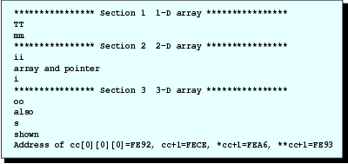
Output
to access the elements of a 1D char array aa putchar(aa[16]);
putchar(*(aa+16));

Slide 106
Pointer Arithmetic
1D array (aa[])
  adding an integer to an address
  aa+16
  gives address of the character indicated by a[16], and
  *(aa+16) gives value of 17th character
2D array (bb[5][40])
putchar(*(*(bb+3)+5));
bb is regarded an address of beginning of one of the rows with each element size 40!
*(bb+3)
represents the address of beginning of fourth row
*(bb+3)+5
is addition of an address, *(bb+3), and integer, 5

Slide 107
Pointer Arithmetic
2D array (bb[5][40])
*(bb+2) is equivalent to bb[2], which represents the address of beginning of third row in bb[ ][ ] array
With the declaration char *dd
dd=&bb[0][0];
putchar(*(dd+125));
prints the 126th character in the bb
dd = bb;
is invalid as dd was declared as a single char pointer, it cannot take on the characteristics of an array address

Slide 108
Pointer Arithmetic
3D array (cc[2][3][20] )
  putchar(cc[1][2][3]);
  putchar(*(*(*(cc+1)+2)+3));
  both print the same character in the cc[ ][ ][ ] array
  *(cc+1)
  When add cc by 1, we add 1 x 3 x 20 = 60 bytes to address indicated by cc
  represents address of beginning of second 2-D array
  *(cc+1)+2
  2 causes the addition of 2 x 20 = 40 bytes
  *(*(cc+1)+2)
  represents the address of beginning of third row
  putchar(*(*(*(cc+1)+2)+3));
  print out a single character at cc[1][2][3]

Slide 109
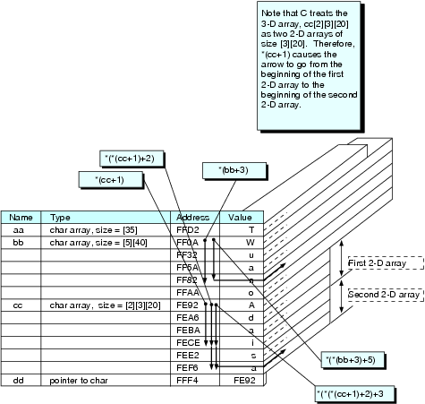

Slide 110
DYNAMIC MEMORY ALLOCATION
problem if try to use fixed-size arrays for maximum possible problem that your program may solve
Better to reserve memory based on the size of problem
functions (calloc, malloc, realloc, and free) that can perform dynamic memory allocation - specify how much memory is to be reserved during execution
return the address of the beginning of the memory reserved

Slide 111
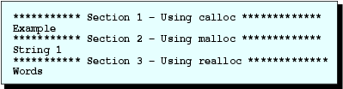
char aa[19],*bb[22],cc[22][19]={"Example", " String 1 ", "Words"};
int xx, yy;
printf ("*********** Section 1 - Using calloc *************\n");
strcpy (aa,cc[0]);
xx = strlen (aa);
bb[0] = (char *) calloc (xx,sizeof(char));
strcpy (bb[0],aa);
puts (bb[0]);
printf ("*********** Section 2 - Using malloc *************\n");
strcpy (aa,cc[1]) ;
xx = strlen (aa);
yy = xx * sizeof(char);
bb[1] = (char *) malloc (yy) ;
strcpy (bb[1], aa);
puts (bb[1]) ;
Output

Slide 112
printf ("*********** Section 3 - Using realloc *************\n");
strcpy (aa, cc[2]);
xx = strlen (aa);
yy = xx*sizeof (char);
bb[1] = (char *) realloc (bb[1], yy);
strcpy (bb[1], aa);
puts (bb[1]) ;
free (bb[1]);
Output

Slide 113
Dynamic Memory Allocation
Syntax for for calloc
calloc (number_of_elements, bytes_per_element)
E.g.
xx = strlen(“example”);
bb[0]=(char *)calloc(xx,sizeof(char));
causes address of beginning of memory reserved to be stored in first element of the pointer array, bb[ ].
8 bytes being reserved
cast operator (char *) causes the pointer returned by calloc to be a pointer to a character

Slide 114
calloc, malloc & realloc
malloc also reserves memory during program execution
malloc (number_of_ bytes)
E.g.
bb[1]=(char *)malloc(yy);
address of beginning of memory reserved to be stored in second element of pointer array bb[ ]
realloc modifies the amount of memory previously reserved by a call to either malloc or calloc
realloc (pointer, number_of_bytes);
memory reserved is equal to the number_of_bytes,

Slide 115
calloc, malloc & realloc
E.g.
bb[1]=(char *) realloc(bb[1],yy);
argument pointer must have been returned by a previous call to either calloc or malloc
If number_of_bytes is less than that previously reserved by calloc or malloc , contents of memory remain unchanged after call to realloc
Otherwise returns pointer to new location (bigger memory area), and , realloc copies the contents of memory from the old to new locations.

Slide 116
free
cancels the reservation for memory previously made by calloc, malloc, or realloc
General form
free (pointer)
E.g.
free(bb[1]);
address stored in bb[1] remains unchanged after the call to free
good practice to free memory once it is not required
should not rely on the operating system to free memory after termination of execution - memory leakage would result

Slide 117
Dynamic memory allocation
What happens if calloc, malloc, or realloc cannot reserve the memory?
=> return a null pointer
Should check the return pointer from these functions to make sure that memory has been successfully allocated
where in memory is the space reserved?
Conceptually, C can be considered to break up memory into four regions:
  A region called the stack.
  A region called the heap.
  A region for global variables.
  A region for program instructions.

Slide 118
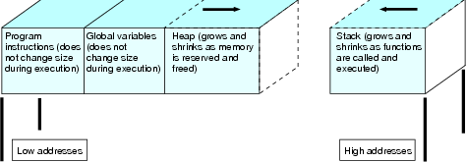
Dynamic memory allocation
stack has high addresses and others are in low addresses
memory is reserved in the heap by the memory management functions (calloc, malloc & realloc)

Slide 119
Thank you!
Q & A

